Slide 1


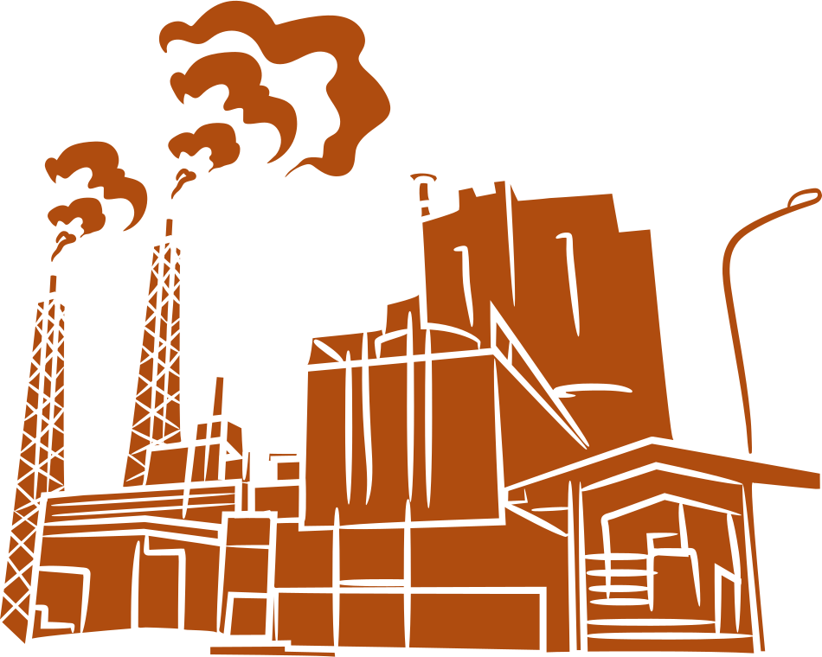
SafeGuard AI
“Preventing Accidents Before They Happen”

Slide 2
The Cost of Human Error in High-Risk Industries
Having worked in a production company, I have witnessed accidents firsthand, seeing how quickly human error can lead to serious injury.
Every year, thousands of workers are injured or killed due to human error in mining and industrial operations.
Delayed emergency responses worsen the impact of accidents, leading to preventable injuries and fatalities.
Existing safety measures are mostly reactive, leaving workers exposed to avoidable risks.

Slide 3
SafeGuard AI – Real-Time Safety Monitoring
Wearable IoT devices monitor workers’ vital signs, movement, and exposure to hazards.
AI-powered platform detects unsafe behavior or dangerous conditions in real-time.
Instant alerts notify workers and supervisors, ensuring rapid action and reducing injury severity.
Predictive analytics prevent accidents before they happen, creating a safer work environment.
Designed specifically to meet the challenges faced by African mines and industrial facilities.

Slide 4
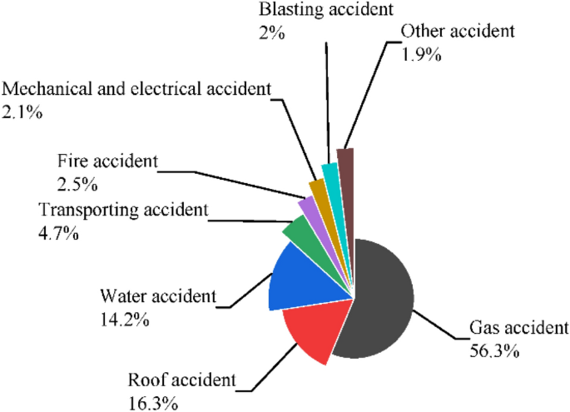
A Growing Need for Industrial Safety in Africa
African mining and industrial sectors are expanding rapidly, but workplace accidents remain a serious concern.
Companies face high costs from injuries—medical expenses, downtime, and insurance claims—which affect both profits and workers’ livelihoods.
SafeGuard AI reduces accidents, saves lives, and helps African industries operate more safely and efficiently.

Slide 5
Why SafeGuard AI Stands Out
Traditional safety equipment reacts after accidents happen; SafeGuard AI is proactive.
Real-time alerts and predictive analytics prevent accidents before they occur.
Integrated emergency response reduces response time, saving lives and costs
Built with African industrial realities in mind, including local infrastructure and common hazards.
“The best safety device is a human mind alert and prepared.” – Anonymous

Slide 6

Thank You

